Slide 1



Sockets and Plugs
Extensibility without boilerplate
Stability without stagnation
Code examples available at
diffplug.com/opensource
Ned Twigg
@nedtwigg
DiffPlug
@diffplug

Slide 2
1, 1,
0, 1,
1, 2,
2 Fibonacci
1 Fibonacci again
3 Numbers
Notes:
“Congress shall make no law respecting an establishment of religion, or prohibiting the free exercise thereof; or abridging the freedom of speech, or of the press; or the right of the people peaceably to assemble, and to petition the Government for a redress of grievances”
- Easy to articulate a principle which turns out to be ambiguous.
- Lawyer technique is to say something three times:
“I promise to tell the truth, the whole truth, and nothing but the truth”
“I give, devise, and bequeath”

Slide 3


The three rules of plugin APIs
1
3
2
PLUG
SOCKET

Slide 4

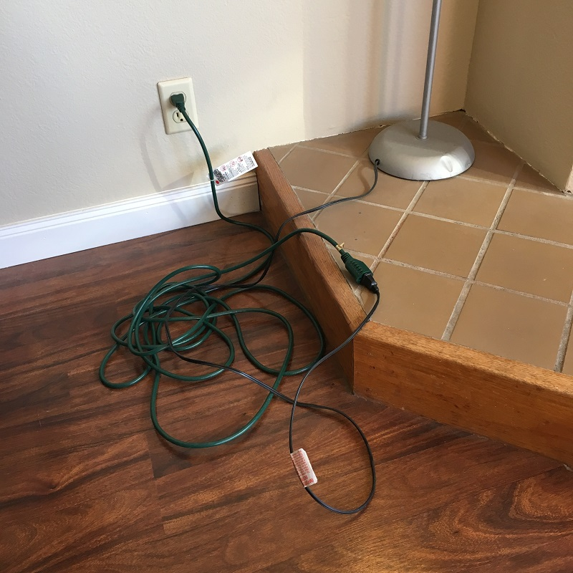
Future-proofing
Notes:
Many sockets have been written which only have one plug, with the idea that we are “future-proofing”.
YAGNI. You Aint Gonna Need It.

Slide 5
The Plan
Look at the plugin system in VSCode
Static sockets, dynamic plugs
Build a calculator in IntelliJ and Eclipse
Dynamic sockets, dynamic plugs
“Declarative” metadata
Maven vs Gradle
Propose a system with the best of all worlds
AutOSGi

Slide 6
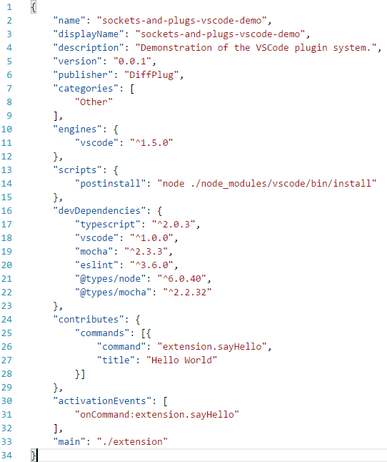
VSCode
package.json (extension manifest)
User-facing information
Similar to maven pom.xml
Dependency and build information
Plugin metadata
Notes:
VSCode -> Extension
Socket -> Contribution Point
Plug -> Contribution

Slide 7
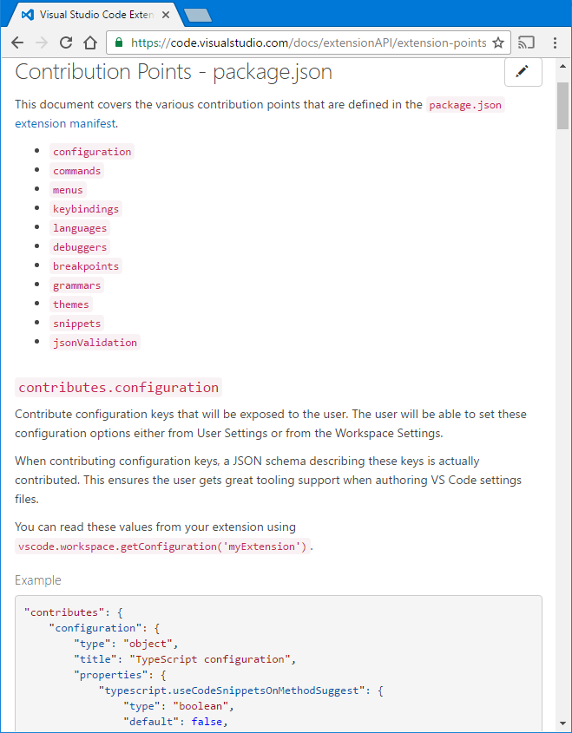
VSCode
package.json

Slide 8
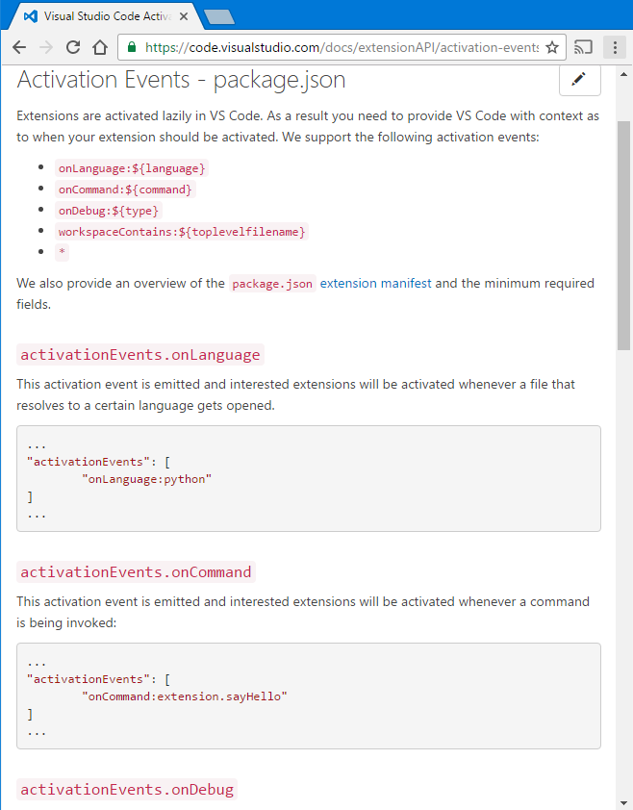
VSCode
package.json

Slide 9
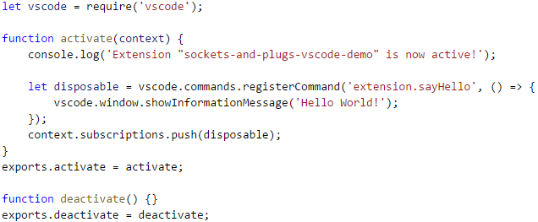
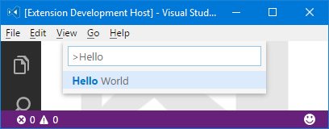
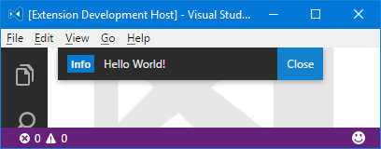
VSCode
extension.js
package.json

Slide 10
VSCode
package.json is a declarative description
What it contributes (to a fixed set of contribution points)
When to load the code (based on a fixed set of activationEvents)
Allows the code to be loaded lazily
Requires synchronizing package.json and the code

Slide 11
IntelliJ and Eclipse
Extension Point -> Socket
Extension -> Plug
public interface Operator {
double calculate(double... args);
}
public class OperatorDescriptor {
public String getName();
public Operator getInstance();
public static List<OperatorDescriptor> all();
public static OperatorDescriptor forName(String name);
}

Slide 12
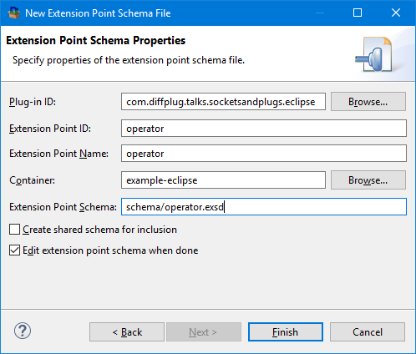
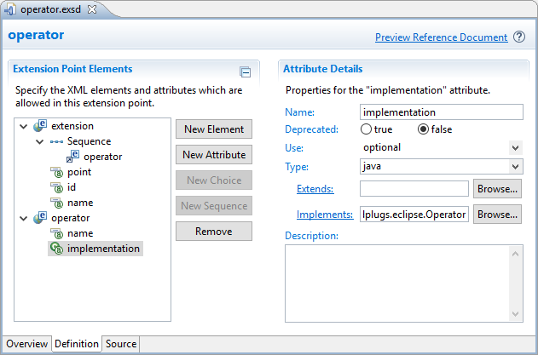
Eclipse
There are only two hard things in Computer Science: cache invalidation and naming things - Phil Karlton
SO LETS GIVE EVERYTHING
TWO NAMES!!!

Slide 13
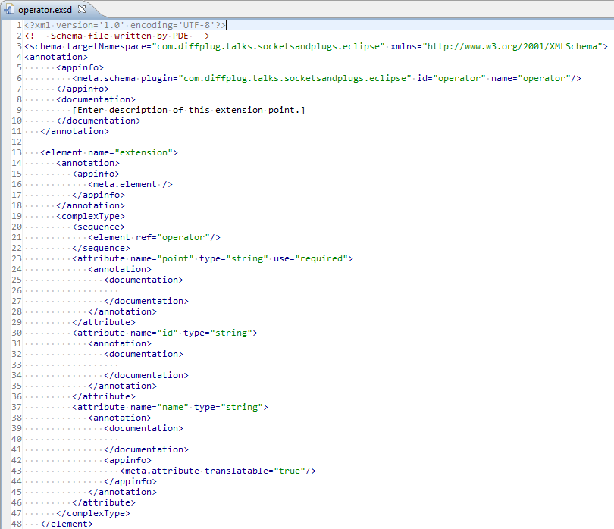
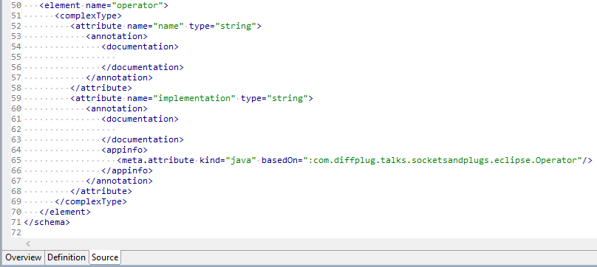
Eclipse
schema/operator.exsd

Slide 14
Eclipse
schema/operator.exsd

Slide 15
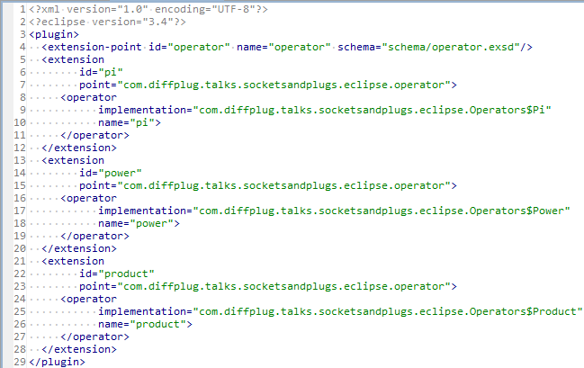
Eclipse
plugin.xml
schema/operator.exsd

Slide 16
Eclipse
plugin.xml
public class OperatorDescriptor {
public String getName();
public Operator getInstance();
public static List<OperatorDescriptor> all();
public static OperatorDescriptor forName(String name);
}

Slide 17
Eclipse
plugin.xml
public class OperatorDescriptor {
private final String name;
private final String implementation;
private OperatorDescriptor(IExtension element) {
IConfigurationElement configElement = element.getConfigurationElements()[0]
name = configElement.getAttribute("name");
implementation = configElement.getAttribute("implementation");
}
public String getName() { return name; }
private Operator instance;
public Operator instantiate() {
if (instance != null) {
return instance;
} else {
Class<?> clazz = Class.forName(implementation);
instance = (Operator) clazz.newInstance();
return instance;
}
}
…

Slide 18
Eclipse
plugin.xml
public class OperatorDescriptor {
…
/** Returns all the OperatorDescriptors in the project. */
public static List<OperatorDescriptor> all() {
IExtensionPoint point = Platform.getExtensionRegistry().getExtensionPoint(
"com.diffplug.talks.socketsandplugs.eclipse.operator");
IExtension[] extensions = point.getExtensions();
return Arrays.asList(extensions).stream()
.map(OperatorDescriptor::new)
.collect(Collectors.toList());
}
/** Returns all the OperatorDescriptors in the project. */
public static OperatorDescriptor forName(String name) {
return all().stream().filter(desc -> desc.name.equals(name)).findFirst().get();
}
}

Slide 19
Eclipse
plugin.xml
public class OperatorDescriptor {
…
/** Returns all the OperatorDescriptors in the project. */
public static List<OperatorDescriptor> all() {
IExtensionPoint point = Platform.getExtensionRegistry().getExtensionPoint(
"com.diffplug.talks.socketsandplugs.eclipse.operator");
IExtension[] extensions = point.getExtensions();
return Arrays.asList(extensions).stream()
.map(OperatorDescriptor::new)
.collect(Collectors.toList());
}
/** Returns all the OperatorDescriptors in the project. */
public static OperatorDescriptor forName(String name) {
return all().stream().filter(desc -> desc.name.equals(name)).findFirst().get();
}
}

Slide 20
Eclipse
schema/socket.exsd
Not that human-friendly XML schema
Eclipse has a nice editor for it
plugin.xml
Contains XML chunks that match the schema
SocketDescriptor.java
Parses the XML and handles the details of the chunks

Slide 21
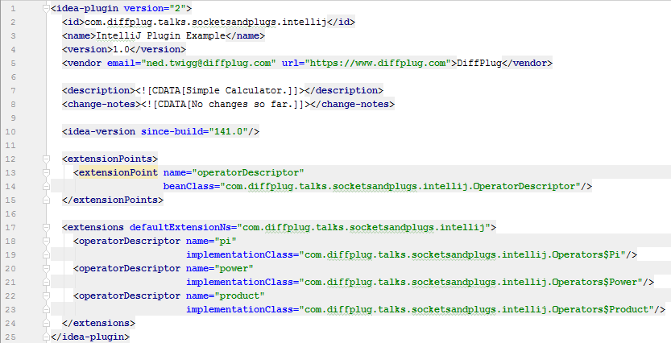
IntelliJ
plugin.xml
User-facing information
Extensions

Slide 22
IntelliJ
plugin.xml
public class OperatorDescriptor extends AbstractExtensionPointBean {
@Attribute("name")
public String name;
@Attribute("implementationClass")
public String implementation;
private Operator instance;
public Operator instantiate() {
if (instance != null) {
return instance;
} else {
Class<?> clazz = Class.forName(implementation);
instance = (Operator) clazz.newInstance();
return instance;
}
}
…

Slide 23
IntelliJ
plugin.xml
public class OperatorDescriptor extends AbstractExtensionPointBean {
…
/** Returns all the OperatorDescriptors in the project. */
public static List<OperatorDescriptor> all() {
ExtensionPointName<OperatorDescriptor> point = new ExtensionPointName<>(
"com.diffplug.talks.socketsandplugs.intellij.operatorDescriptor");
return Arrays.asList(point.getExtensions());
}
/** Returns all the OperatorDescriptors in the project. */
public static OperatorDescriptor forName(String name) {
return all().stream().filter(desc -> desc.name.equals(name)).findFirst().get();
}
}

Slide 24
IntelliJ
plugin.xml (extensionPoints)
<extensionPoint name="socketName" beanClass="SocketDescriptor"/>
SocketDescriptor.java
Extends AbstractExtensionPointBean
Marks attributes with @Attribute
plugin.xml (extensions)
<socketName attr1="value1" attr2="value2"/>

Slide 25
What do they all have in common?
Socket Interface
Contract that the Plug must satisfy
Metadata Format
Contract that the Metadata must satisfy
CONSTRAINS _
CONSTRAINS
Eclipse : schema/socket.exsd
IntelliJ: plugin.xml -> extensionPoint’s beanClass
-> AbstractExtensionPointBean -> @Attribute
VSCode : https://code.visualstudio.com/docs/
extensionAPI/extension-points
public interface Operator {
double calculate(double... args);
}
Socket Descriptor
API for declarative metadata
INSTANTIATES
PARSES
public class OperatorDescriptor {
public String getName();
public Operator getInstance();
public static List<OperatorDescriptor> all();
public static OperatorDescriptor forName(String name);
}
PARSES
Metadata
Declarative description of the plug
Plug Implementation
Implements the Socket Interface
<operator name="pi" impl="com.diffplug.Pi"/>
public class Pi implements Operator {
double calculate(double... args) {
return 3.14159;
}
}
vscode.commands.registerCommand(
'extension.sayHello', () => {
// action body
})

Slide 26
What do they all have in common?
Socket Interface
Contract that the Plug must satisfy
Socket Descriptor
API for declarative metadata about each Plug
CONSTRAINS _
CONSTRAINS
INSTANTIATES
PARSES
public interface Operator {
double calculate(double... args);
}
public class OperatorDescriptor {
public String getName();
public Operator getInstance();
public static List<OperatorDescriptor> all();
public static OperatorDescriptor forName(String name);
}
PARSES
Metadata
Declarative description of the plug
Plug Implementation
Implements the Socket Interface
<operator name="pi" impl="com.diffplug.Pi"/>
public class Pi implements Operator {
double calculate(double... args) {
return 3.14159;
}
}
vscode.commands.registerCommand(
'extension.sayHello', () => {
// action body
})

Slide 27
What is “declarative” metadata?
declare according to dictionary.com
to make known or state clearly, especially in explicit or formal terms
to manifest; reveal; show

Slide 28
Which is more declarative?
to make known or state clearly, especially in explicit or formal terms
to manifest; reveal; show
A)
B)
C)
[1, 2, 3, 4]
List<Integer> list = new ArrayList<>();
for (int i = 1; i <= 4; ++i) {
list.add(i);
}
range(1, 4)

Slide 29
Which is more declarative?
to make known or state clearly, especially in explicit or formal terms
to manifest; reveal; show
A)
B)
C)
[1, 2, 3, 4, 5, 6, 7, 8, 9, 10, 11, 12, 13, 14, 15, 16, 17, 18, 19, 20, 21, 22, 23, 24, 25, 26, 27, 28, 29, 30, 31, 32, 33, 34, 35, 36, 37, 38, 39, 40, 41, 42, 43, 44, 45, 46, 47, 48, 49, 50, 51, 52, 53, 54, 55, 56, 57, 58, 59, 60, 61, 62, 63, 69, 65, 66, 67, 68, 69, 70, 71, 72, 73, 74, 75, 76, 77, 78, 79, 80, 81, 82, 83, 84, 85, 86, 87, 88, 89, 90, 91, 92, 93, 94, 95, 96, 97, 98, 99, 100]
List<Integer> list = new ArrayList<>();
for (int i = 1; i <= 100; ++i) {
list.add(i);
}
range(1, 100)

Slide 30
Maven vs Gradle

Slide 31
Code examples available at
diffplug.com/opensource
Ned Twigg
@nedtwigg
DiffPlug
@diffplug

Slide 32
Stuff after this is draft / scratchpad

Slide 33

Boilerplate
Notes:
Image used with permission: https://www.flickr.com/mail/72157671594455393

Slide 34
IntelliJ
Components (eagerly-loaded)
Application, Project, Module
Services (lazily-loaded)
Same divisions as components, but loaded lazily
Actions
Declarative similar to VSCode’s commands
Used to be lazy-loaded, now eagerly-loaded (ref)
Extension Points and Extensions

Slide 35
Eclipse vs IntelliJ
plugin.xml (extensionPoints)
<extensionPoint name="socketName" beanClass="SocketDescriptor"/>
SocketDescriptor.java
Extends AbstractExtensionPointBean
Marks attributes with @Attribute
plugin.xml (extensions)
<socketName attr1="value1" attr2="value2"/>
schema/socket.exsd
Not that human-friendly XML schema
Eclipse has a nice editor for it
plugin.xml
Contains XML chunks that match the schema
SocketDescriptor.java
Parses the XML and handles the details of the chunks

Slide 36
Eclipse
e4
Modeled workbench
Describe application with XML
Includes declarative commands/handlers
Sits on top of OSGi
Services
Declarative services
Very powerful, very complex
Extension Points and Extensions

